Slide 1
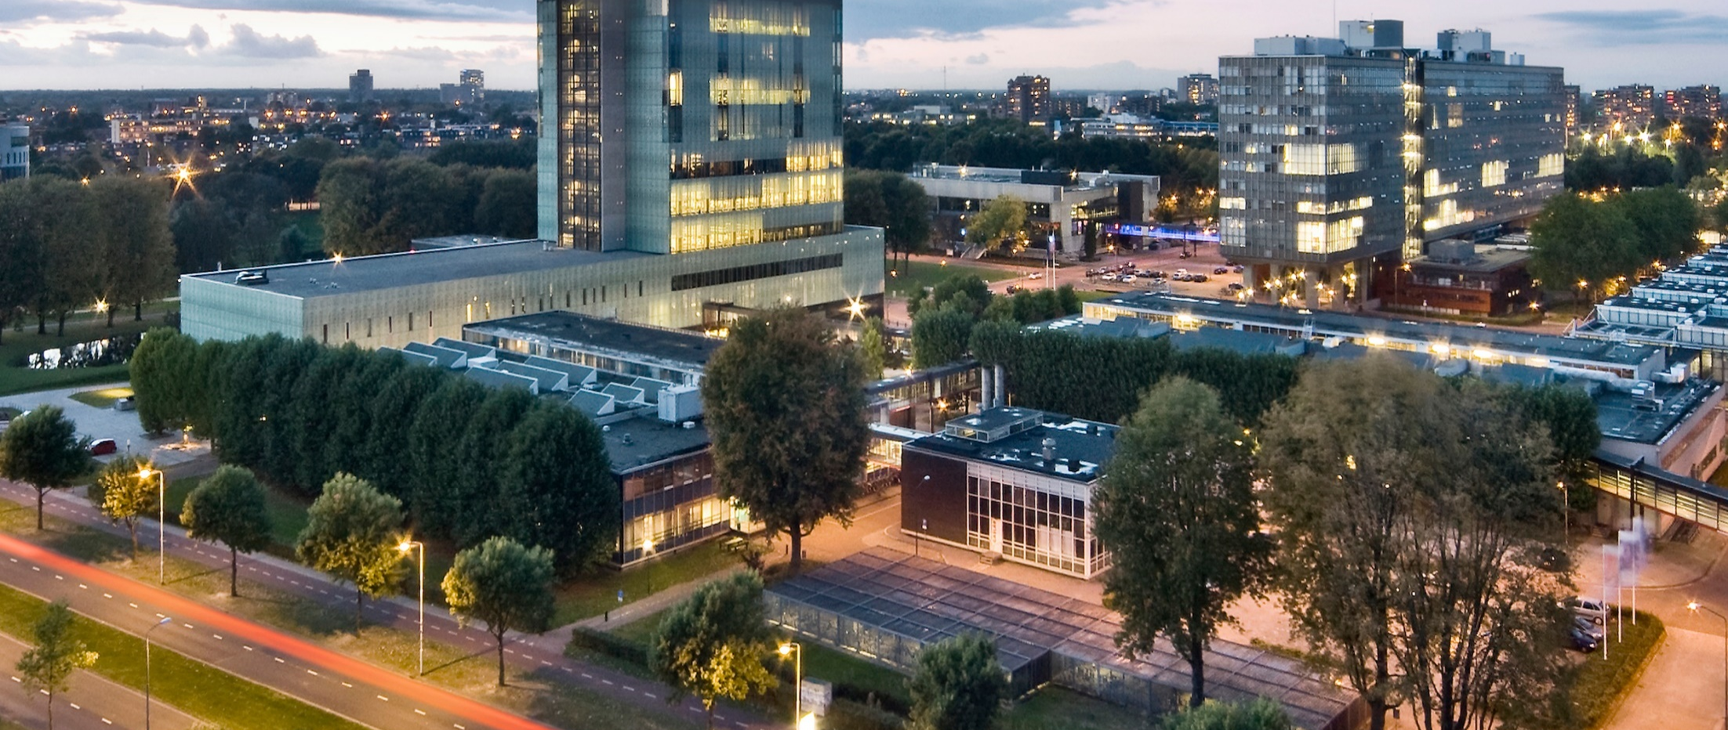
Golden Ratio
DAY1-COORDINATE-SYSTEMS
Prof. dr. ir. Loe Feijs
Department of Industrial Design, TU Eindhoven

Slide 2
Resources
Processing3, please install from
https://processing.org/download/
Github, digital-craftmanship’s repository GOLDEN-RATIO
this powerpoint (.pptx)
circle.pde
fromCircleToSpiral.pde
https://github.com/digital-craftsmanship/GOLDEN-RATIO/tree/master/DAY1-COORDINATE-SYSTEMS
External link, Paul's Online Math Notes
http://tutorial.math.lamar.edu/Classes/CalcII/PolarCoordinates.aspx

Slide 3
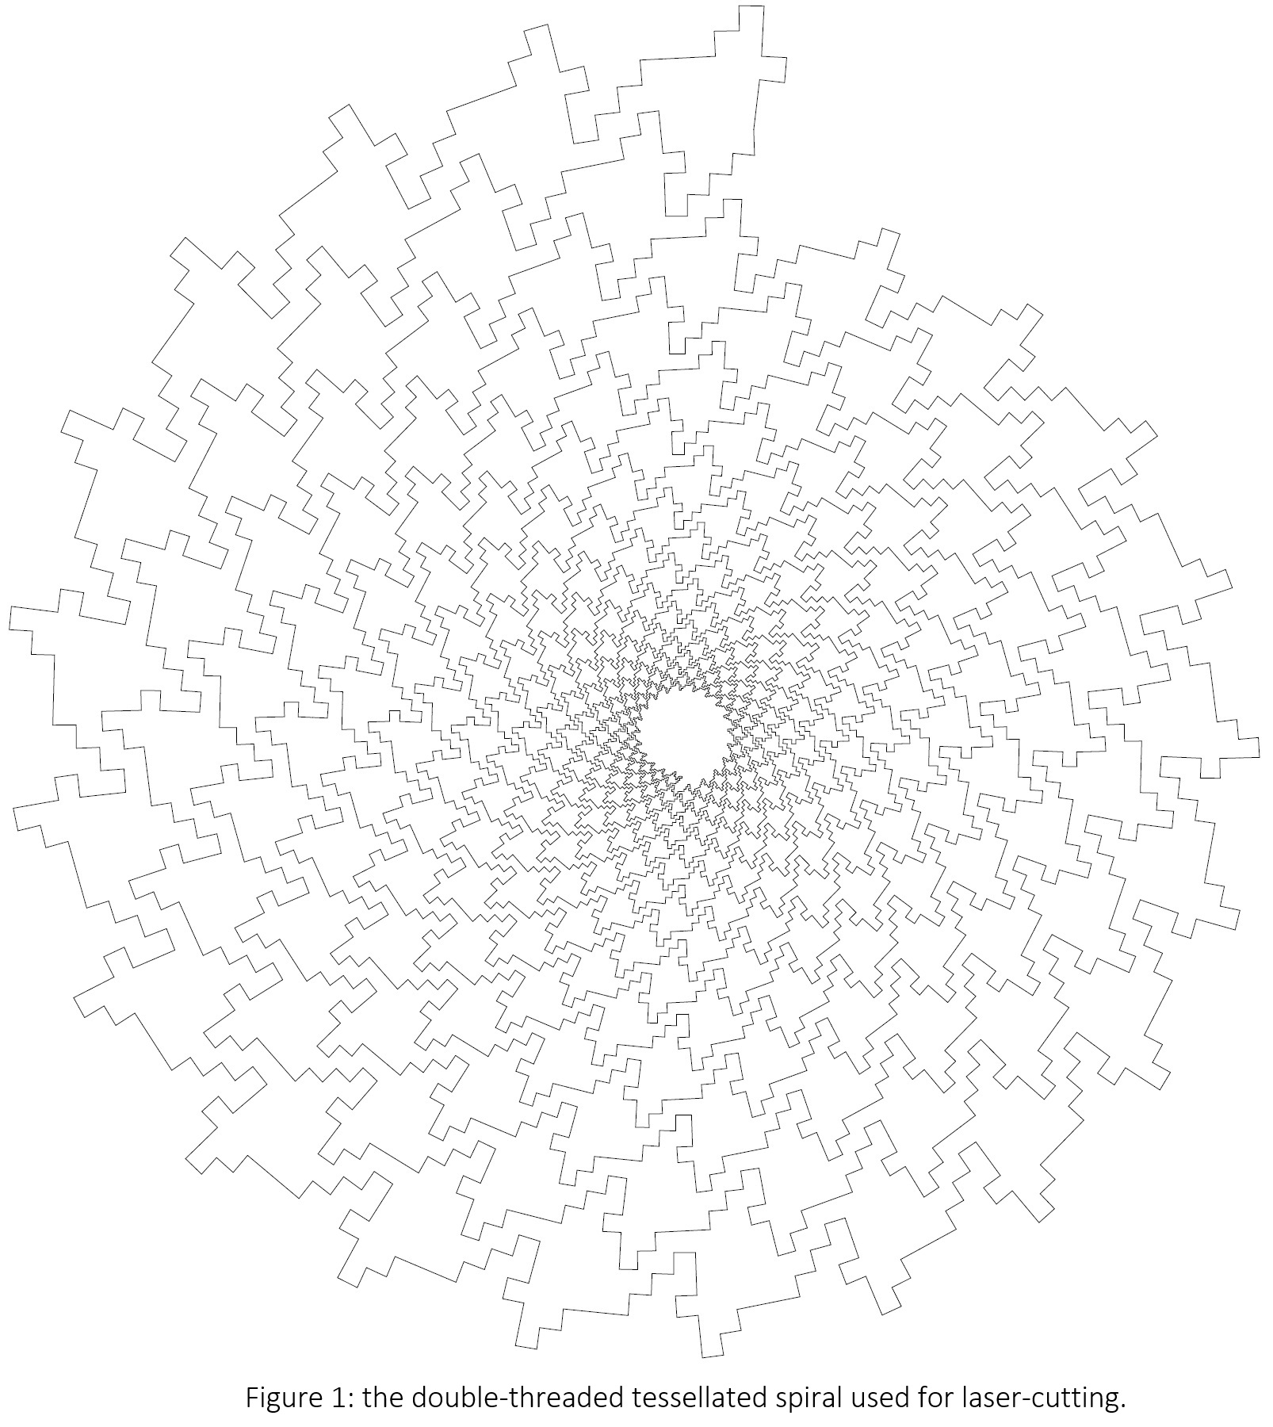

Inspiration

Slide 4
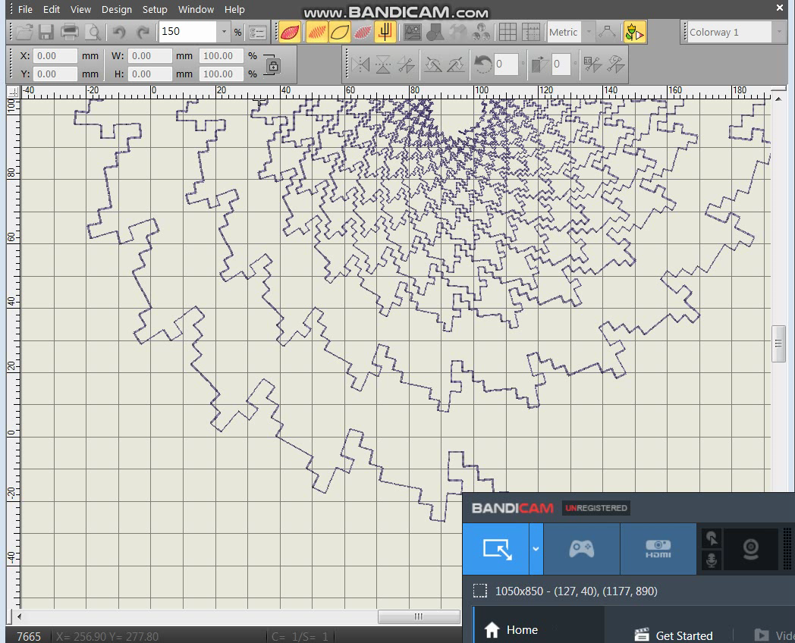
Inspiration

Slide 5
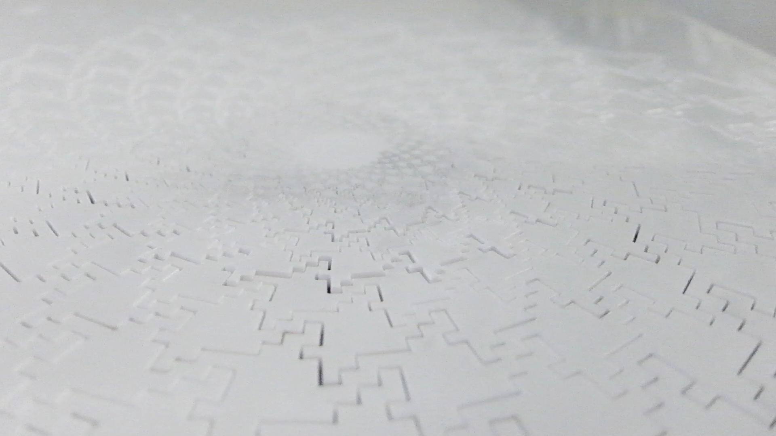
Inspiration

Slide 6

Inspiration

Slide 7
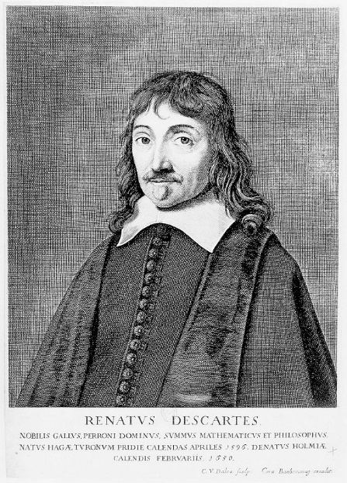
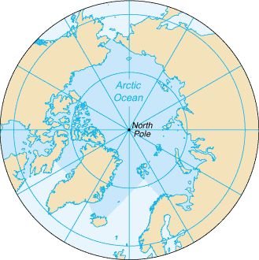
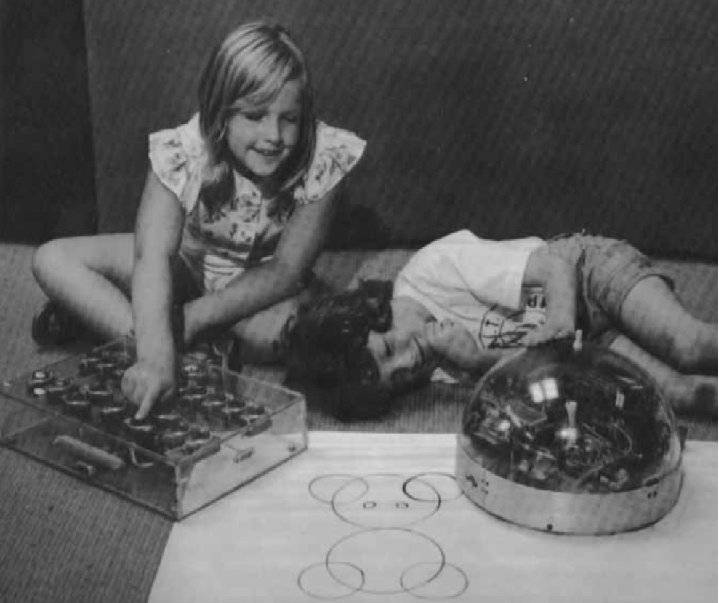
Popular coordinate systems
Cartesian: (x,y)
polar: (r,ϑ)
turtle graphics: forward(L), right(ϑ)
Source: upload.wikimedia.org/wikipedia/commons /5/59/Arctic_Ocean_-_en.png
Children playing with turtle around 1976. Source: Seymour Papert, “Mindstorms” (book cover)

Slide 8
Coordinate systems: details
Aproaches to indicate angles:
degrees: 0 .. 360º
radians: 0 .. 2 π

Slide 9
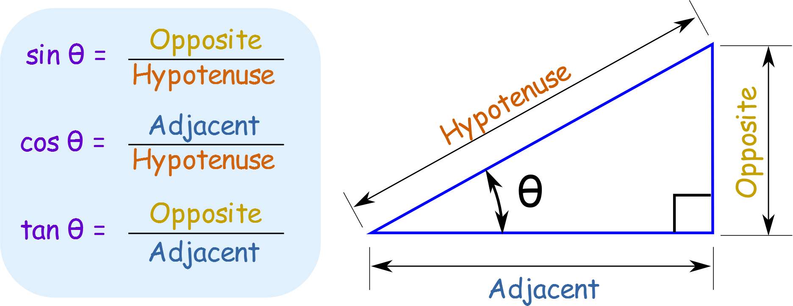
Switching between coordinate systems
Trigonometric functions:
Source: www.mathsisfun.com/sine-cosine-tangent.html

Slide 10
To be continued at the lightboard

Slide 11
Two examples in Processing
circle.pde
fromCircleToSpiral.pde

Slide 12
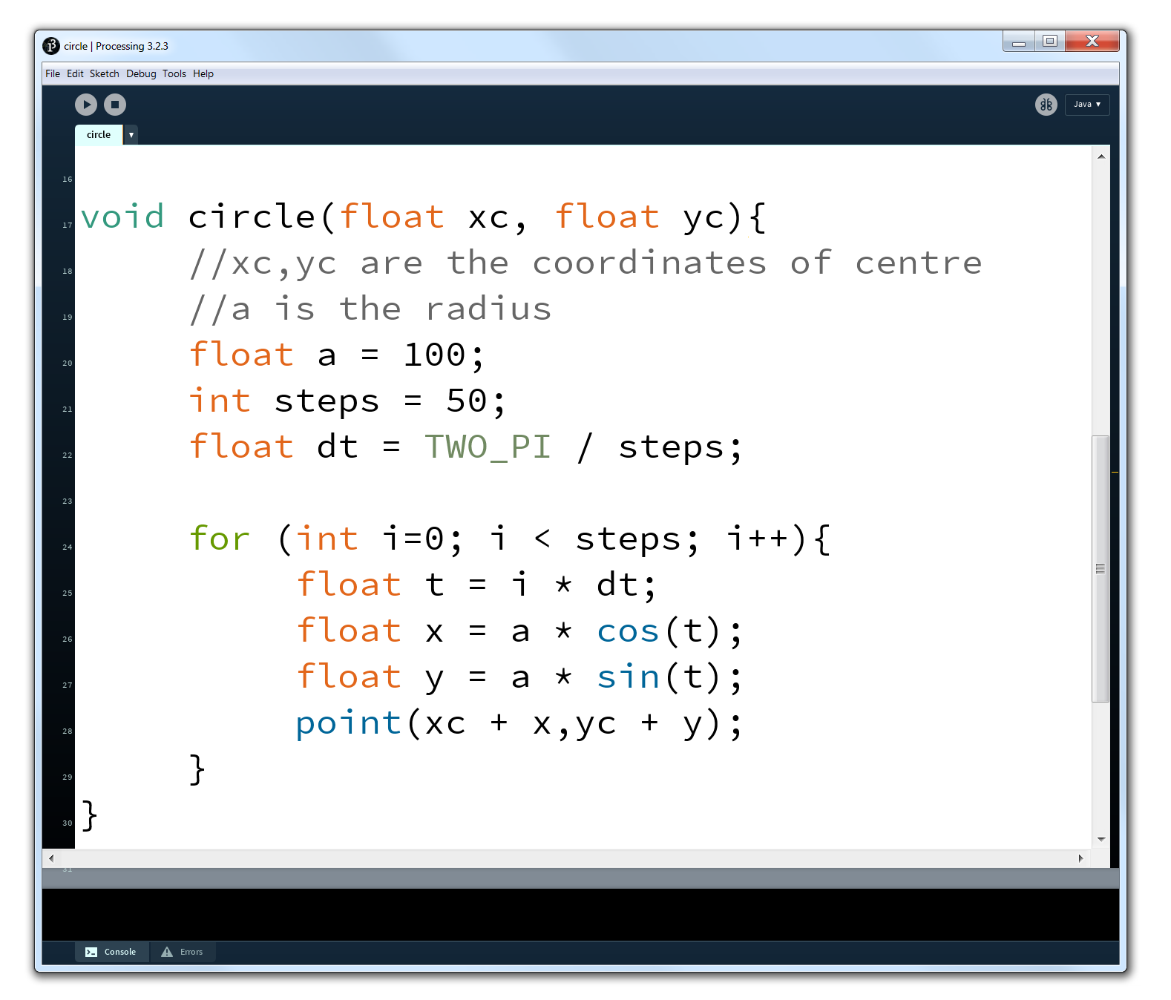
Switching between coordinate systems

Slide 13
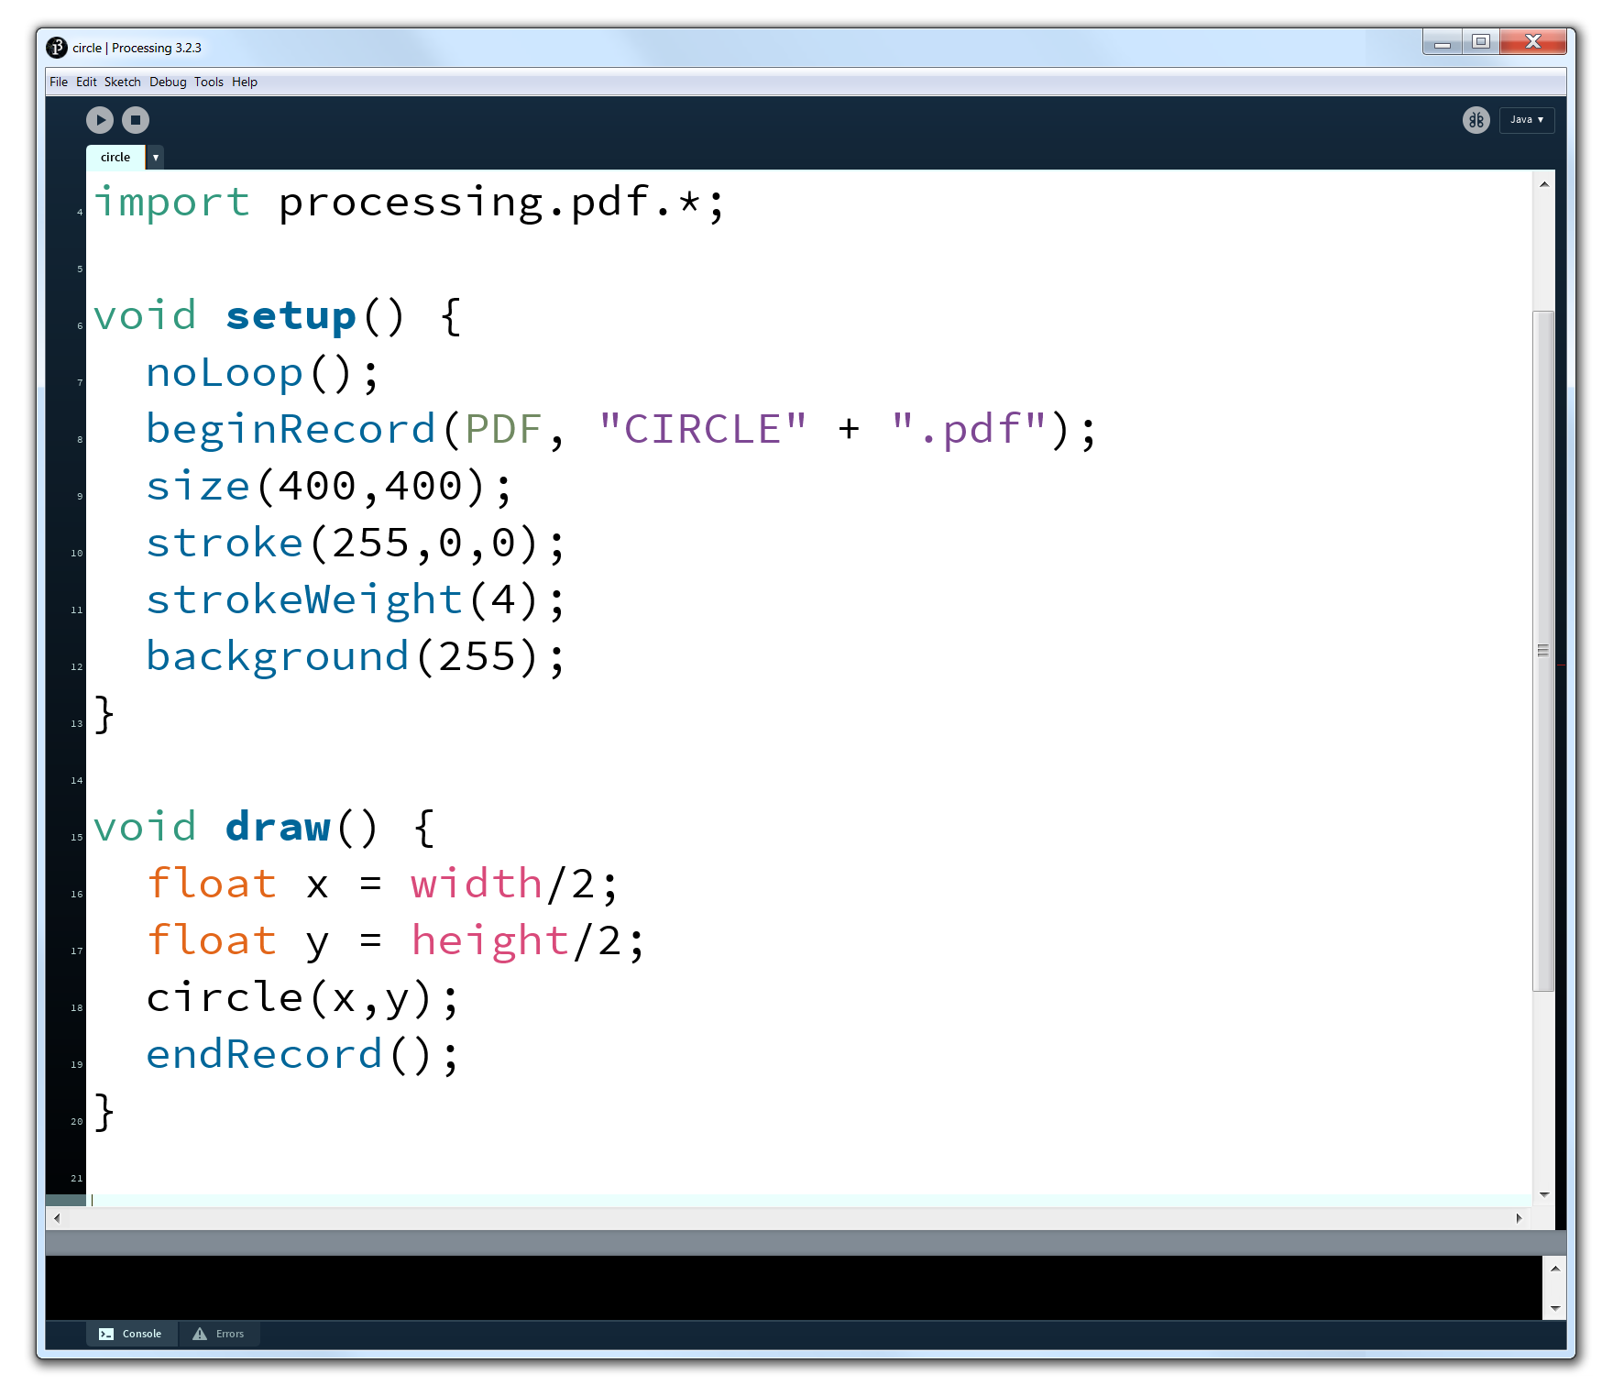

Slide 14
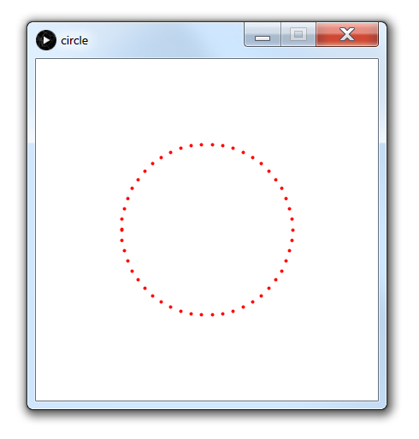

Slide 15
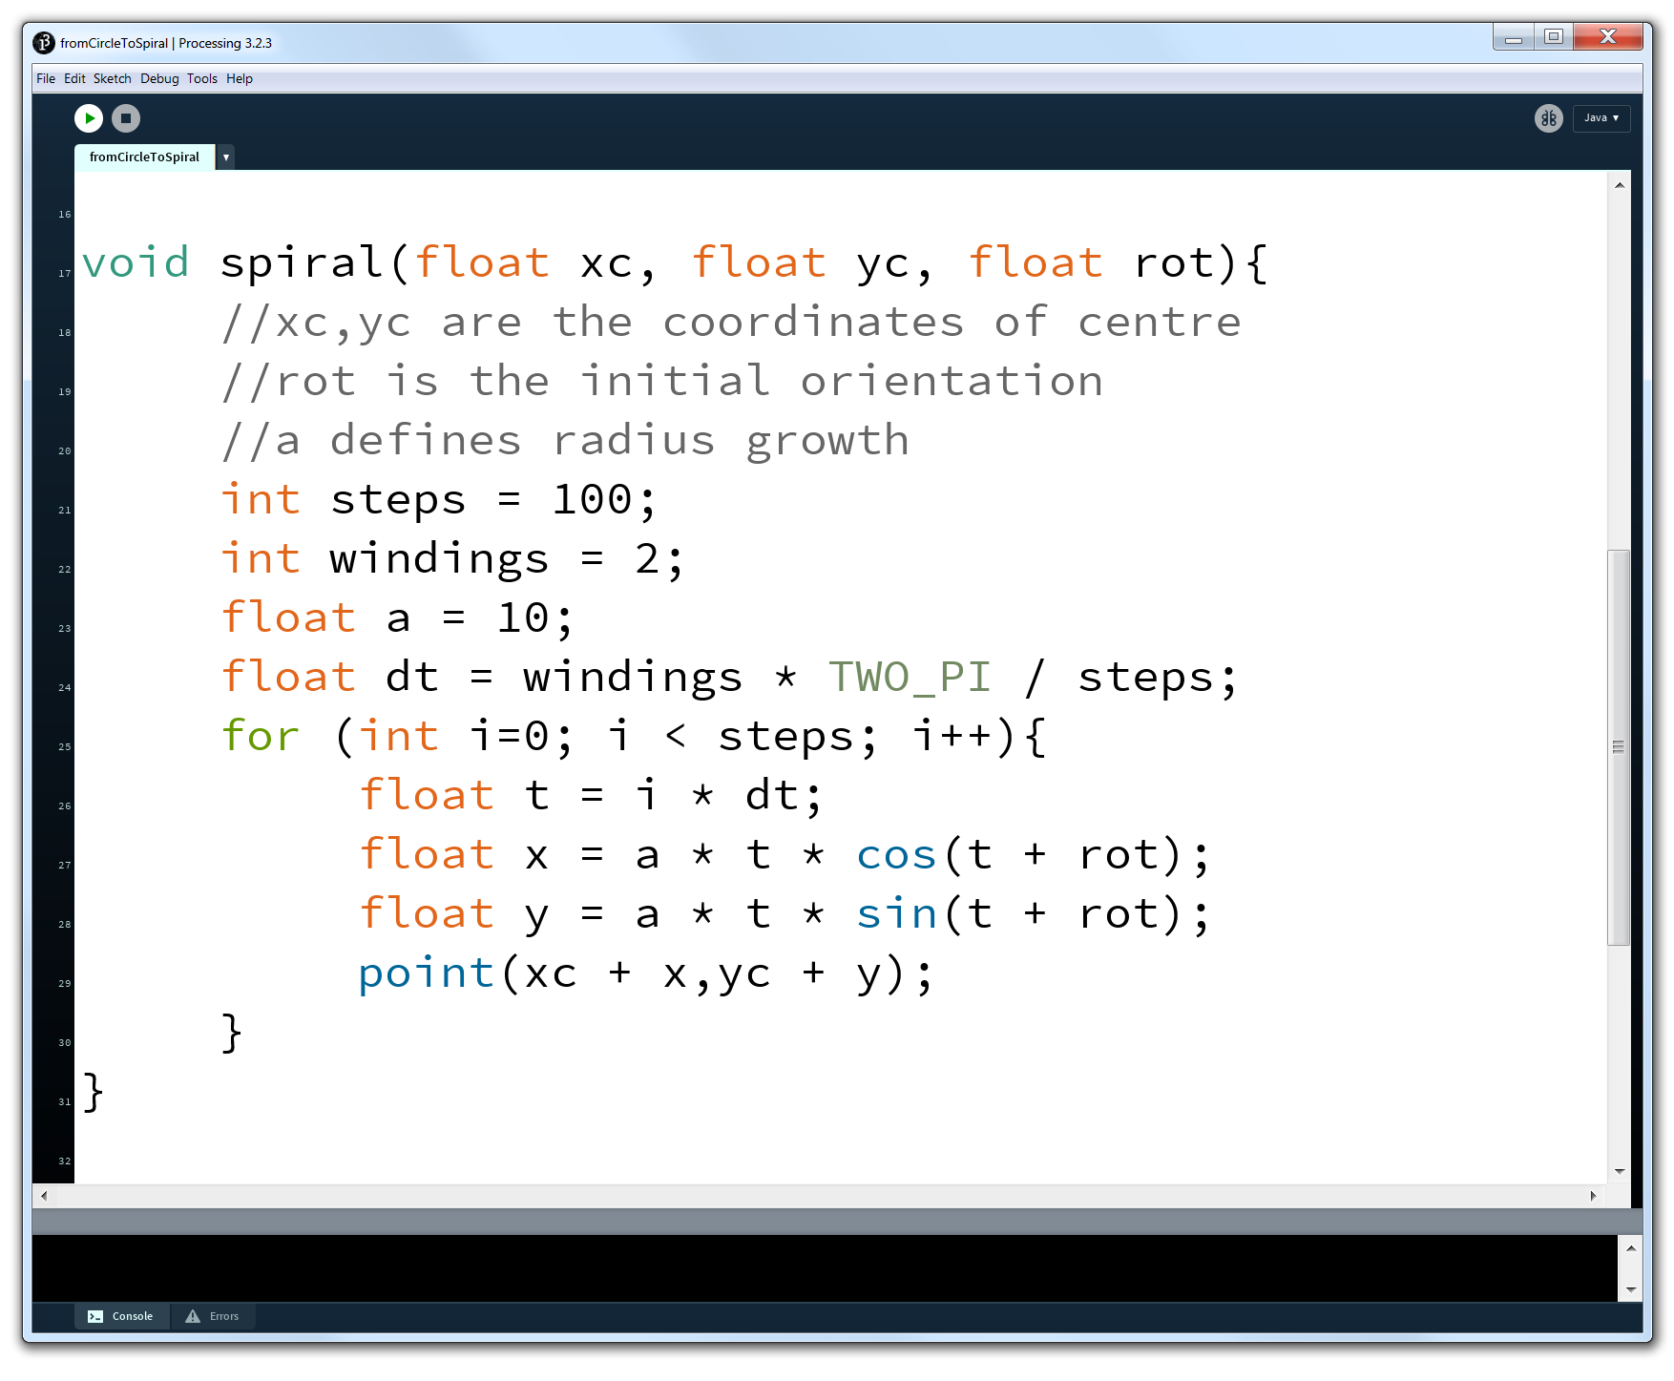

Slide 16
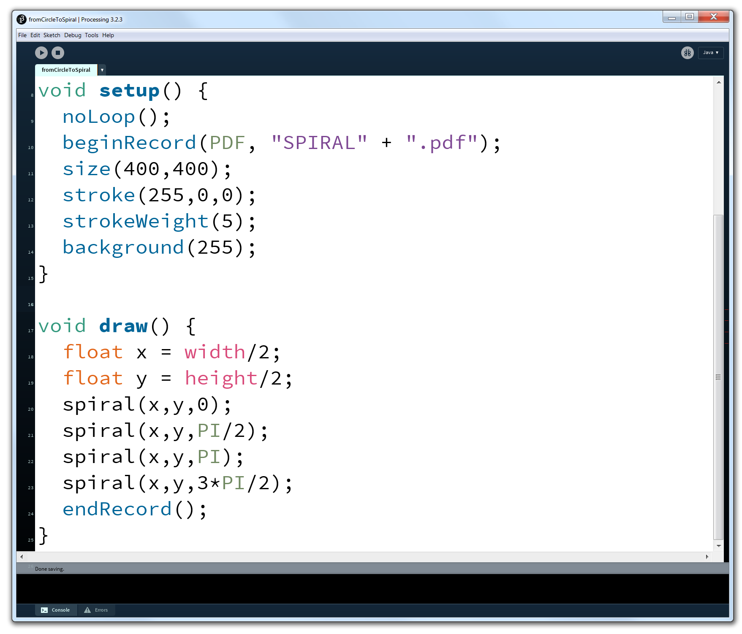

Slide 17
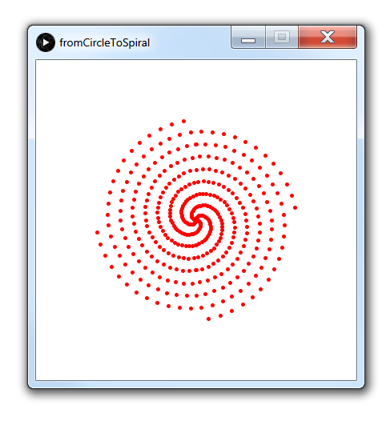

Slide 18
Recap and reflection
computers like Cartesian coordinates
circles and spirals go best with polar coordinates
you can mediate between the two using sin, cos, tan
next, code your formulas in Processing
thus obtain beautiful results

